Slide 1

HARBIY XAVFSIZLIK VA MUDOFAA UNIVERSITETINING
AXBOROT-KOMMUNIKATSIYA TEXNOLOGIYALARI VA HARBIY ALOQA INSTITUTI
2-MAVZU: PyQt5 paketi va QtDesigner dasturi yordamida GUI dasturlarini yaratish
O‘qituvchi: “Axborot texnologiyalari va sun’iy intellekt” kafedrasi “Sun’iy intellekt” sikli katta o‘qituvchisi katta leytenant Qodomboyev R.O‘.
Toshkent 2026

Slide 2
2-mavzu. 3-mashg‘ulot (Guruhli):
PyQt5 kutubxonasi. QLineEdit vidjeti.

Slide 3
PyQt5 kutubxonasi. QLineEdit vidjeti.
O‘quv savollari:
QLineEdit vidjeti.
setStyleSheet() metodi.

Slide 4
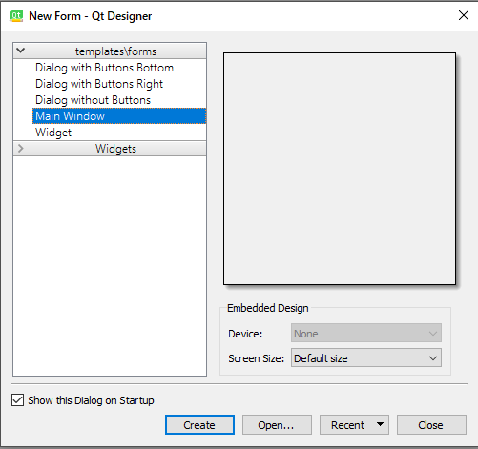
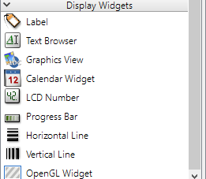
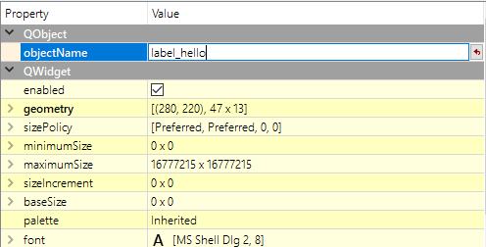
QLineEdit vidjeti:
1. Qt Designerda .ui fayl yaratish
Qadamlar:
Qt Designerni oching.
“Main Window” yoki “Dialog without Buttons” tanlang.
Chap tomondan Widget Box → Display Widgets → Label ni oyna ichiga olib chiqing.
Labelning objectName xususiyatini (Properties oynasida) label_hello deb o‘zgartiring.
Faylni main.ui nomi bilan saqlang.

Slide 5
2. .ui faylni Python kodda yuklash
Biz .ui faylni ikkita yo‘l bilan ishlatishimiz mumkin:
1-usul: uic.loadUiType() orqali to‘g‘ridan-to‘g‘ri yuklash
Bu usul .ui faylni to‘g‘ridan-to‘g‘ri ochadi, hech qanday konvertatsiya kerak emas.
from PyQt5 import uic
from PyQt5.QtWidgets import QApplication, QMainWindow
import sys
class MyApp(QMainWindow):
def __init__(self):
super().__init__()
uic.loadUi("main.ui", self) # UI faylni yuklash
# QLabel vidjetini ID orqali chaqirish
self.label_hello.setText("Salom, PyQt5 va Qt Designer!")
app = QApplication(sys.argv)
win = MyApp()
win.show()
sys.exit(app.exec_())

Slide 6
2-usul: .ui faylni .py faylga aylantirish
Agar .ui faylni kod shaklida ishlatmoqchi bo‘lsangiz, pyuic5 yordamida uni .py ga o‘tkazasiz:
pyuic5 -x main.ui -o main_ui.py
Keyin main_ui.py faylni dasturda import qilib ishlatish mumkin:
from PyQt5.QtWidgets import QApplication, QMainWindow
from main_ui import Ui_MainWindow # .ui dan o‘tgan kod
import sys
class MyApp(QMainWindow):
def __init__(self):
super().__init__()
self.ui = Ui_MainWindow()
self.ui.setupUi(self)
self.ui.label_hello.setText("Qt Designer bilan ishladik!")
app = QApplication(sys.argv)
win = MyApp()
win.show()
sys.exit(app.exec_())

Slide 7
QLabel nima?
QLabel — bu PyQt5 kutubxonasidagi eng oddiy, lekin eng ko‘p ishlatiladigan vidjetlardan (elementlardan) biridir. U matn (text) yoki rasm (image) ko‘rsatish uchun ishlatiladi.
Ya’ni, QLabel — bu ko‘rsatish (display) uchun mo‘ljallangan vidjetdir, foydalanuvchidan ma’lumot olmaydi, faqat ma’lumotni chiqaradi.
QLabel vazifalari
QLabel quyidagi asosiy vazifalarni bajaradi:
Matnni ko‘rsatish Oddiy yoki formatlangan (HTML) matnni chiqara oladi.
label.setText("Salom, PyQt5!")
2. Shrift va o‘lchamni o‘zgartirish Matn shriftini, o‘lchamini va rangini o‘zgartirish mumkin:
from PyQt5.QtGui import QFont
label.setFont(QFont("Arial", 14))

Slide 8
3. Rasm (Pixmap) ko‘rsatish QLabel yordamida rasmni ekranga chiqarish oson:
from PyQt5.QtGui import QPixmap
label.setPixmap(QPixmap("rasm.png"))
4. HTML yoki link ko‘rsatish QLabel HTML formatni tan oladi:
label.setText('<a href="https://python.org">Python saytiga o‘tish</a>')
label.setOpenExternalLinks(True)
5. Matn joylashuvini boshqarish Matnni chapga, o‘rtaga yoki o‘ngga tekislash mumkin:
from PyQt5.QtCore import Qt
label.setAlignment(Qt.AlignCenter)
6. Chegara (ramka) va fon berish CSS uslubida style berish mumkin:
label.setStyleSheet("border: 1px solid gray; background-color: #eef;")

Slide 9

Misollar
1-misol. QLabel yaratish
from PyQt5.QtWidgets import QApplication, QLabel, QWidget, QVBoxLayout
import sys
app = QApplication(sys.argv)
win = QWidget()
layout = QVBoxLayout(win)
label = QLabel("Salom, QLabel!")
layout.addWidget(label)
win.show()
sys.exit(app.exec_())

Slide 10
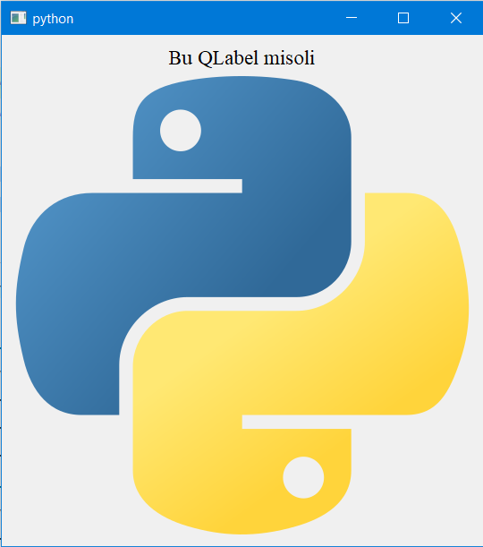
2-misol:
from PyQt5.QtWidgets import QApplication, QLabel, QWidget, QVBoxLayout
from PyQt5.QtGui import QFont, QPixmap
from PyQt5.QtCore import Qt
import sys
app = QApplication(sys.argv)
win = QWidget()
layout = QVBoxLayout(win)
# Matnli label
label1 = QLabel("Bu QLabel misoli")
label1.setFont(QFont("Times New Roman", 14))
label1.setAlignment(Qt.AlignCenter)
# Rasmli label
label2 = QLabel()
label2.setPixmap(QPixmap("python_logo.png"))
label2.setScaledContents(True)
layout.addWidget(label1)
layout.addWidget(label2)
win.show()
sys.exit(app.exec_())

Slide 11
2. setStyleSheet() metodi.
1. Asosiy: matn (text) bilan ishlash
label.setText("Salom!") # QLabel ga matn yozish yoki mavjud matnni yangilash
current = label.text() # joriy matnni olish
setText() — matn yozish yoki mavjud matnni yangilash.
text() — joriy matnni qaytaradi.
2. Oddiy matn va HTML (Rich text)
from PyQt5.QtCore import Qt
label.setTextFormat(Qt.PlainText) # qat'iy oddiy matn
label.setText("1 < 2 & 3") # PlainText bo'lsa HTML teglari ishlamaydi
label.setTextFormat(Qt.RichText) # HTML (rich text) ishlaydi
label.setText('<b>Qalin</b> va <span style="color:red">qizil</span>')
label.setOpenExternalLinks(True) # <a href="..."> linklarini tashqi brauzerda ochish
Qt avtomatik aniqlaydi, lekin kerak bo‘lsa .setTextFormat() bilan aniq belgilash mumkin.

Slide 12
3. Font (shrift) — QFont yordamida
from PyQt5.QtGui import QFont
f = QFont("Arial", 14) # oilasi va point-size (nuqta o'lchami)
f.setBold(True) # qalin
f.setItalic(True) # kursiv
f.setUnderline(True) # ostiga chizish
f.setWeight(75) # vazn: 0-99 (normal ~50, bold ~75)
label.setFont(f)
QFont(family, pointSize) — family (masalan "Arial"), pointSize — nuqtada.
setWeight(int) aniq nazorat uchun.
setPixelSize(px) — agar piksel asosida aniq o‘lchash kerak bo‘lsa:
f.setPixelSize(20)

Slide 13
4. Style sheet (CSS uslubida) bilan font va rang
label.setStyleSheet("font-family: 'Times New Roman'; font-size: 18pt; color: #2a7ae2;")
font-size da pt yoki px ishlatish mumkin (18pt, 16px).
Style sheet yordamida yana font-weight, font-style va boshqalarni ham berish mumkin:
label { font-weight: bold; font-style: italic; }
5. Matn joylashuvi, margin, indent va o‘rash
from PyQt5.QtCore import Qt
label.setAlignment(Qt.AlignCenter) # AlignLeft, AlignRight, AlignTop, AlignVCenter ...
label.setMargin(8) # ichki chekka (pixel)
label.setIndent(10) # matnni chapdan surish
label.setWordWrap(True) # uzun matnni yangi qatorga o'rash
setWordWrap(True) — matn label kengligiga sig‘masa avtomatik yangi qatorga o'tadi.

Slide 14
6. Matn tanlash va interaktivlik (link, select)
from PyQt5.QtCore import Qt
label.setTextInteractionFlags(Qt.TextSelectableByMouse) # sichqoncha bilan tanlash mumkin
label.setTextInteractionFlags(Qt.TextBrowserInteraction) # link va tanlash kombinatsiyasi
# Link signali:
label.setText('<a href="hello">Bos!</a>')
label.linkActivated.connect(lambda href: print("Link bosildi:", href))
linkActivated(str) — ichki link bosilganda chaqiriladi.
setOpenExternalLinks(True) — tashqi linklarni brauzerda ochadi.

Slide 15
7. Matnni labelga sig‘dirish: QFontMetrics va elide
Agar matn labelga sig‘masa, uni ... bilan qisqartirish:
from PyQt5.QtGui import QFontMetrics
from PyQt5.QtCore import Qt
fm = QFontMetrics(label.font())
elided = fm.elidedText("Bu juda uzun matn...", Qt.ElideRight, label.width())
label.setText(elided)
Qt.ElideRight — oxiridan ... qo‘yadi. ElideLeft, ElideMiddle ham bor.

Slide 16
8. Avtomatik shrift moslash (fit-to-width) — kod misoli
Bu funksiyani oynani ko‘rsatgandan yoki o‘lchami o‘zgarganda chaqiring.
def fit_font_to_label(label, text, min_size=6, max_size=48):
from PyQt5.QtGui import QFont, QFontMetrics
from PyQt5.QtCore import Qt
for size in range(max_size, min_size-1, -1):
f = QFont(label.font().family(), size)
fm = QFontMetrics(f)
if fm.horizontalAdvance(text) <= label.width():
label.setFont(f)
label.setText(text)
return
# agar hech qaysi sigmasa, elide qilamiz
fm = QFontMetrics(label.font())
label.setText(fm.elidedText(text, Qt.ElideRight, label.width()))
Bu label kengligiga mos holda eng katta shriftni topadi.

Slide 17
9. Rasm bilan ishlash va shrift bilan bog‘liq (pixmap)
Agar QLabel rasm ko‘rsatsa:
from PyQt5.QtGui import QPixmap
label.setPixmap(QPixmap("img.png"))
label.setScaledContents(True) # label o'lchamiga moslab o'zgartiradi
setScaledContents(True) rasmni label o‘lchamiga moslashtiradi — sifatga e’tibor bering.

Slide 18
10. Joriy shrift va parametrlarni olish
f = label.font() # QFont obyekti
family = f.family()
pt = f.pointSize()
px = f.pixelSize()
bold = f.bold()
italic = f.italic()
underline = f.underline()

Slide 19
